Slide 1

Weekly Review
25/05/21
Tasks
Run with new action – corner in policy X – Losses still increase
Write a stable baselines implementation
Problems
Learning results unexpected
Memory gets saturated in Stable Baselines implementation
To-Do Items for Next Week
Make stable baselines implementation work
Show code corresponding to learning plots
Add all hyperparameters used

Slide 2
Weekly Review
25/05/21
X
(0,0,0)
y

Slide 3
Weekly Review
25/05/21
0.03
X
y
(-0.09,-0.15,0.007)
(-0.09,-0.12,0.007)
(0.00,0.00,0.007)
(-0.09,-0.09,0.007)
(-0.09,-0.06,0.007)
Defined in cloth_corner.xml

Slide 4
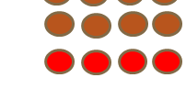
Weekly Review
25/05/21
State
Exp : Cloth_corner.py
X
y
Action
[-1, -1, -1] to [1, 1, 1] on 1 random corner
OR
[X, X, X, X, -1, -1, -1] to [X, X, X, X 1, 1, 1]
Where XXXX is a one hot representation of a corner
[1,0,0,0] – Corner 1
[0,1,0,0] – Corner 2
[0,0,1,0] – Corner 3
[0,0,0,1] – Corner 4
To environment scale = *0.05
Force applied =
proportional to the
distance to be moved
(-0.05, -0.05)
X
X
(0.05, 0.05)

Slide 5
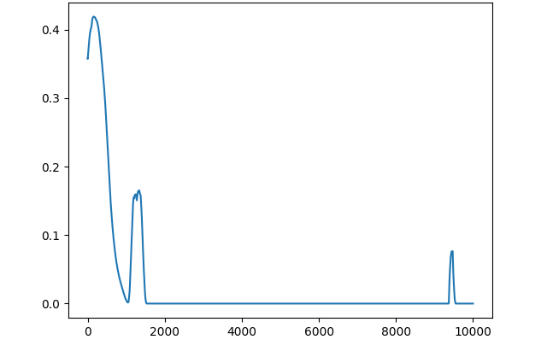
Weekly Review
25/05/21
1 step = no. of steps in 1 episode / game
Reward
No. of steps

Slide 6
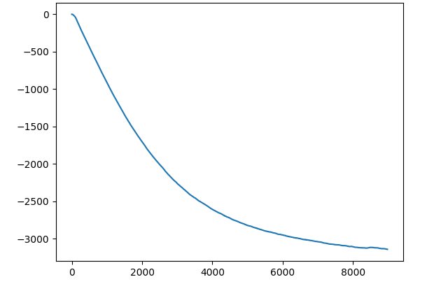
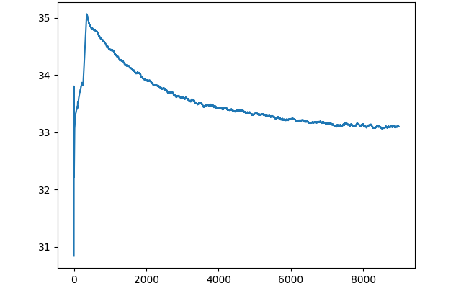

Weekly Review
25/05/21
1 step = average value over 1 batch
Critic network output
Actor network output
Critic value
entropy
No. of steps
No. of steps
Value network output
Target Value network output
Value
Target Value
No. of steps
No. of steps

Slide 7
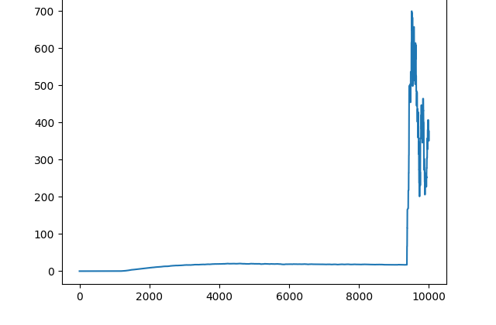
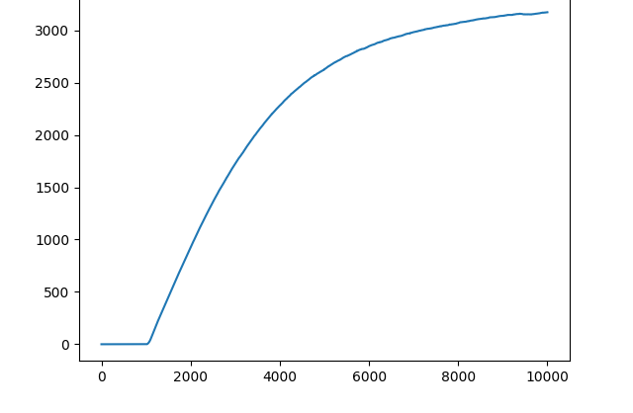
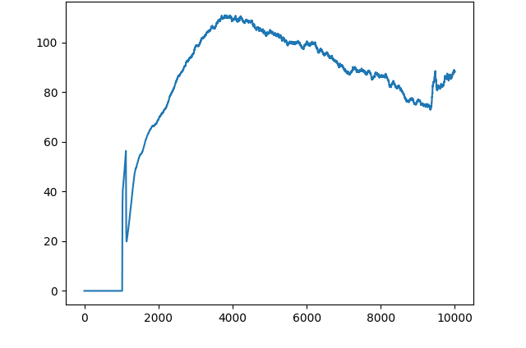
Weekly Review
25/05/21
1 step = loss after 1 batch
Actor loss
Critic loss
No. of steps
No. of steps (batch_size)
Value loss
Target Value loss
No. of steps (batch_size)
No. of steps (batch_size)

Slide 8
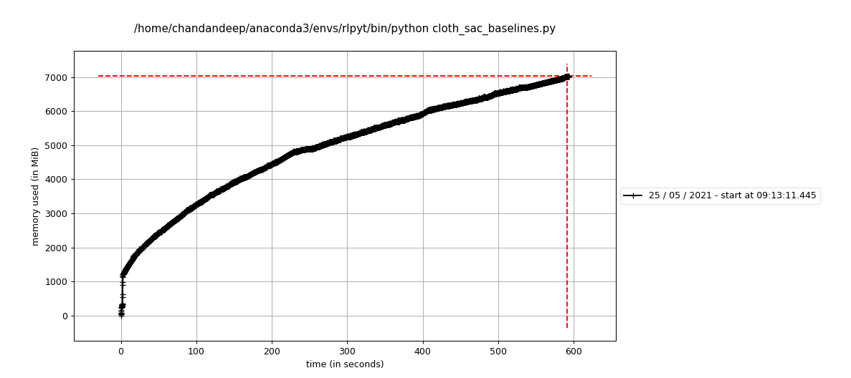
Weekly Review
25/05/21
Stable baselines implementation
Convert DMControlSuite cloth_corner environment
to OpenAI gym environment
Memory gets saturated on running

Slide 9
THANK YOU

